Slide 1
SMART HELMET WITH EFFECTIVE ALCOHOL DETECTION BY USING IOT
BATCH NO-06
BATCH NAME- TACKLE
BATCH MEMBER-
MONISHA K-20BCB4023
SHALINI A.S-20BCB4038
SWARNA VARSHINI M-20BCB4042

Slide 2
ABSTRACT:
Motorcycle riders have a unique relationship to motorcycles, so motorcycle safety is specifically tied to several elements of the vehicle, such as equipment model, vehicle design, and operator skill. They are, nevertheless, the most dangerous road users since, in the absence of a protective body, even the slightest carelessness can result in serious injuries or even the rider's death. In addition to carelessness, other factors that contribute to death include excessive speeding, careless driving, excessive alcohol usage, and breaking traffic laws. But the lack of a helmet on the victim was the primary cause of brain damage, which results in instant death.

Slide 3
PROBLEM STATEMENT :
According to a survey, in India two wheelers account for 25% of total road crash deaths. The main reasons for the fatalities are drunken driving, delay in treatment post accident and serious injury sans helmet. The main objective of this project is to design an intelligent system which will prevent a drunk person from driving . This system is capable of providing security and safety to the bikers against road accidents. The circuit is so designed that the bike won’t start without wearing helmet and if the rider is drunk.

Slide 4
OBJECTIVE :
The main objective of this project is to design an intelligent system which will prevent a drunk person from driving and also identify accident if any. This system is capable of providing security and safety to the bikers against road accidents. The circuit is so designed that the bike won’t start without wearing helmet and if the rider is drunk.
KEYWORD:
Arduino Pro mini 328, Piezo electric sensor, RF communication systems

Slide 5
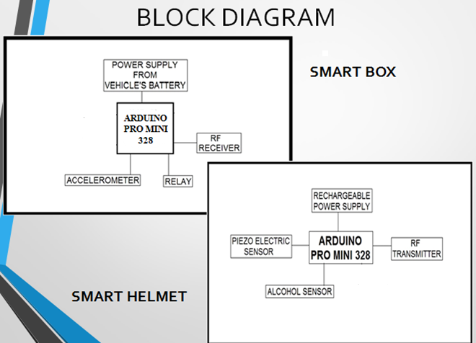
BLOCK DIAGRAM:

Slide 6
BLOCK DIAGRAMS & DESCRIPTION
To develop a prototype of the product that includes the following Technologies:
Arduino Pro mini 328
Piezo electric sensor
Rechargeable battery
RF communication systems

Slide 7
WORK PLAN
Collect and buy product-1WEEK
Set up the product-1WEEK
Implement the connection-2WEEK
Testing and Debuging-3WEEK
Final Competion-1WEEK
Correction-1WEEK

Slide 8
METHODOLOGY:
This entire unit is powered by the battery. Smart helmet comprises of Arduino Pro mini 328,Piezo electric sensors, MQ3 alcohol sensor, RF transmitter, RFID tag and a rechargeable battery.
Here the Smart box is integrated with Smart helmet in such a way that the rider can start his vehicle only when he wears helmet and also if he is sober. After switching the bike ON, the rider must bring his helmet near to the Smart box to feed the RFID reader with RFID tag value.
The rider must now put on the helmet and after evaluation, a signal will be sent through RF transmitter which will be sending a code with RFID tag value.

Slide 9
The receiver present in the Smart box will accept the code. Galileo board will read the code and activate the relay. After this the rider can start ignition.
An SOS message with the accident location will be sent to the mobile numbers which are preloaded by rider(he can set those numbers by sending a message to gsm module) and immediate help can be provided.

Slide 10
REQUIRED HARDWARE AND BUDGET:
Arduino pro mini 328-Rs.2000(2 pieces)
MQ-3 alcohol sensor Rs.1250
RF transmitter and receiver 434MHZ (RKI 1064)-Rs.500
Rechargeable battery-Rs.750
Piezo electrice sensor

Slide 11
LITERATURE SURVEY
Madhuchhanda Dasgupta, Oishila Bandyopadhyay, Sanjay Chatterji, Computer Science & Engineering IIIT Kalyani West Bengal, India,” Automated Helmet Detection for Multiple Motorcycle Riders using CNN”.The ability to continuously monitor vehicle compliance with traffic rules is an important component of any effective traffic management system.
Dikshant Manocha, Ankita Purkayastha, Yatin Chachra, Namit Rastogi, Varun Goel Department of Electronics and Communication Engineering Jaypee Institute of Information Technology Noida, India,” Helmet Detection Using ML & IoT”. Presented to me this paper is focused on predicting unhelmet needs from the data of two-circling cyclists without a centralised authentication.

Slide 12
Fahad A Khan, Nitin Nagori, Dr. Ameya Naik, Department of Electronics & Telecommunication K.J.Somaiya college of Engineering Mumbai, India,” Helmet and Number Plate detection of Motorcyclists using Deep Learning and Advanced Machine Vision Techniques”. presented to me Since the recent increase in use of motorcycles has made it more difficult to keep the roads clear, crashes and injuries are on the rise.
Bhavin V Kakani, Divyang Gandhi, Sagar Jani, E&C Engineering Department Institute of Technology Nirma University,” Improved OCR based Automatic Vehicle Number Plate Recognition using Features Trained Neural Network”. presented to me A major portion of the current focus in intelligent transportation is on expanding algorithms and discoveries in the research and development realm. A significant improvement is necessary in traffic and parking/facility regulation, and traffic control with the use of a rapid, integrated and highly reliable automatic recognition plates reading system

Slide 13
FUTURE ENHANCEMENT:
We can improve the security by implementing the iris detection and implement them to not get theft by others without accessing . We provide the security details only to the users.

